Slide 1
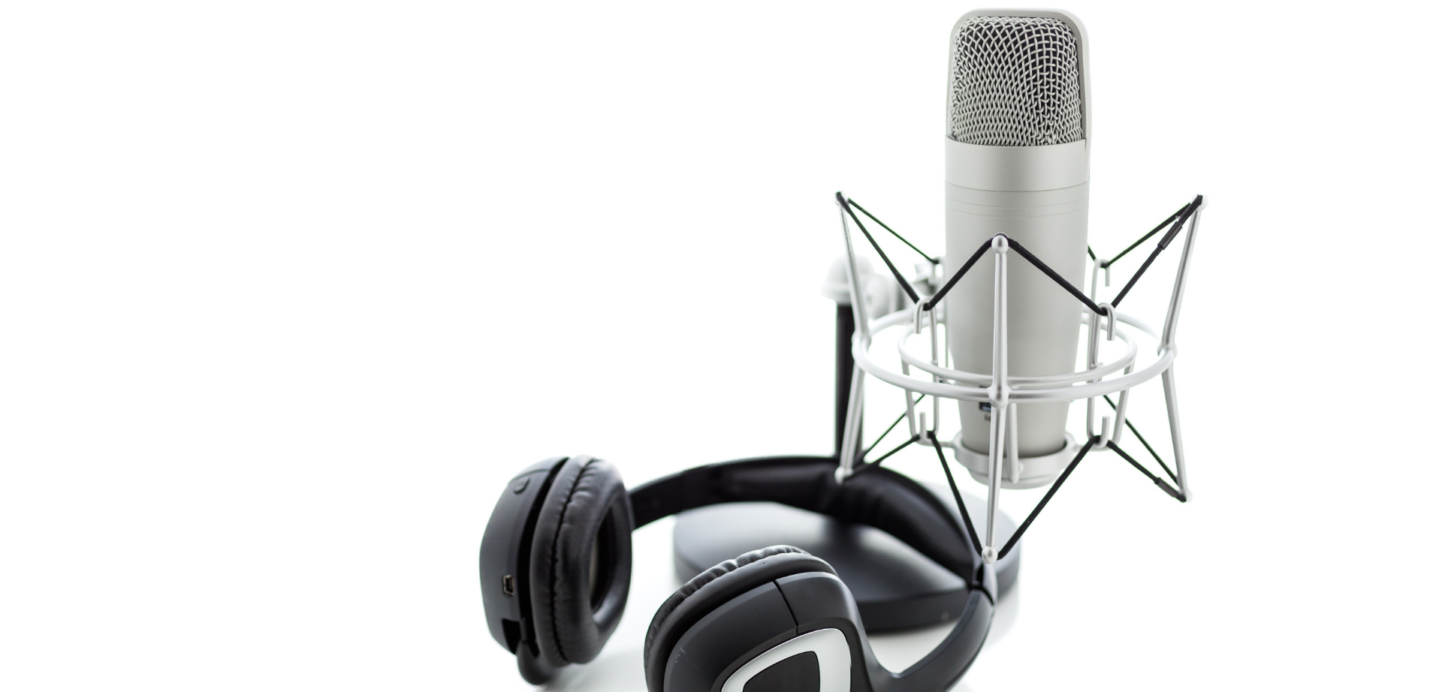
AUSTRALIAN PODCAST CONSUMER TRENDS
www.podcastservices.com.au

Slide 2
40% of Australians have listened to a podcast in the last month.
…making Australia the world’s biggest podcast listening nation
Source: The Infinite Dial Australia 2022 - Edison Research

Slide 3
MONTHLY PODCAST LISTENING
% of total Australian population who listened to a podcast in the last month:
Source: The Infinite Dial Australia 2022 - Edison Research

Slide 4
90% of Australians
know what a podcast is.
Source: The Infinite Dial Australia 2022 - Edison Research

Slide 5
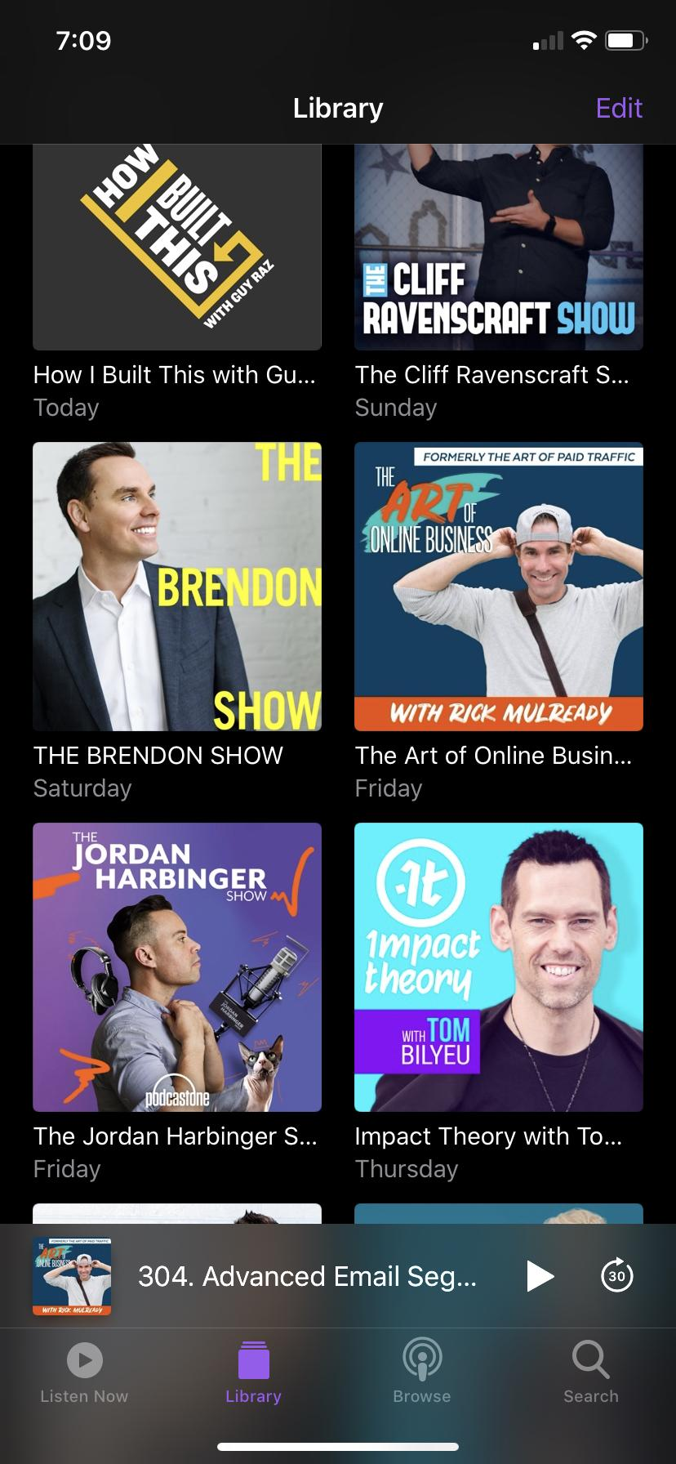
WHY DO PEOPLE
LISTEN TO PODCASTS?
To be informed and learn new things
Podcasts offer a diverse range of perspectives
No screen time - people can multitask while listening
Accessibility - most people own a smartphone

Slide 6
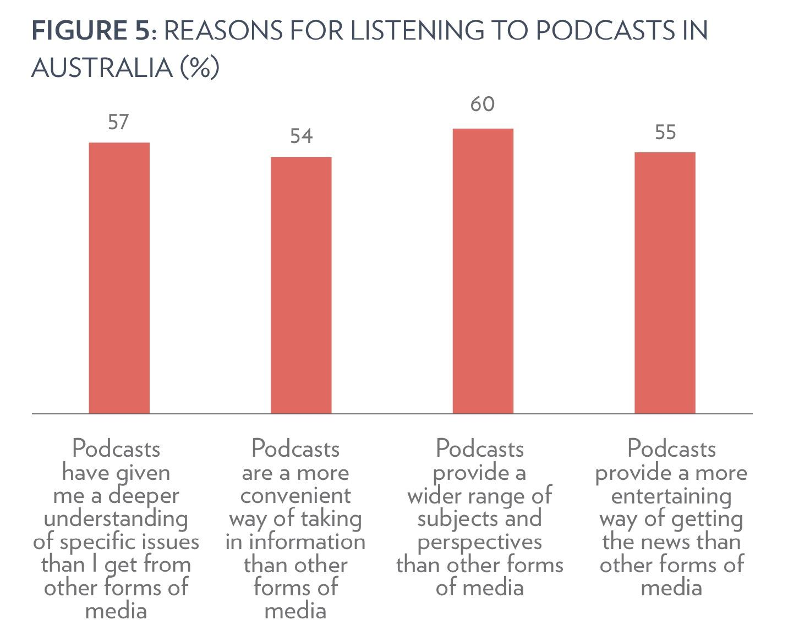
WHY DO PEOPLE LISTEN TO PODCASTS?
Source: Podcast Trends & Issues in Australia & Beyond: Global Perspectives.
Source: ABC Audience Data & Research 2019

Slide 7
7 hours and 6 minutes is the average time podcast listeners spend listening each week.
Source: The Infinite Dial Australia 2022 - Edison Research

Slide 8
NUMBER OF PODCAST EPISODES LISTENED TO IN THE LAST WEEK
Australian weekly podcast listeners averaged SEVEN EPISODES in the last week.
Source: The Infinite Dial Australia 2022 - Edison Research

Slide 9
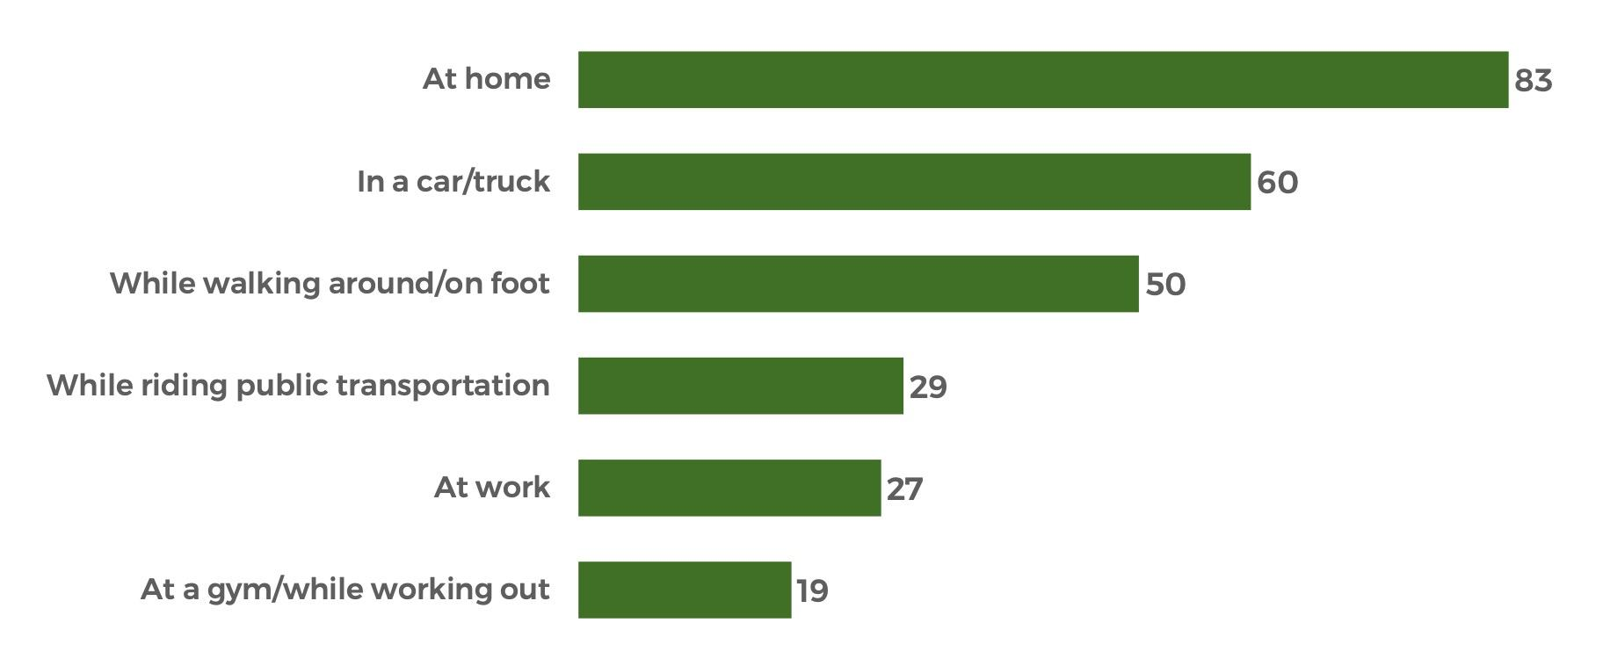
WHERE DO AUSTRALIANS LISTEN TO PODCASTS? (%)
Source: The Infinite Dial Australia 2022 - Edison Research

Slide 10
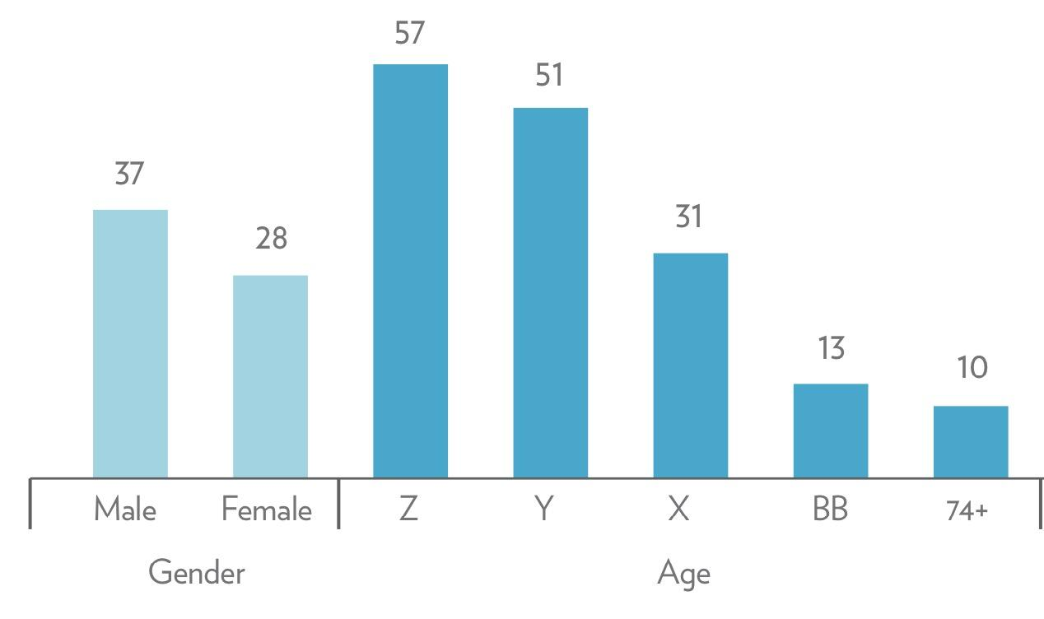
AUSTRALIAN PODCAST LISTENERS BY DEMOGRAPHIC (%)
Source: Sang, Y., Lee, J.Y., & Park, S. (2020). Podcast Trends & Issues in Australia & Beyond: Global Perspectives. News & Media Research Centre, University of Canberra.

Slide 11
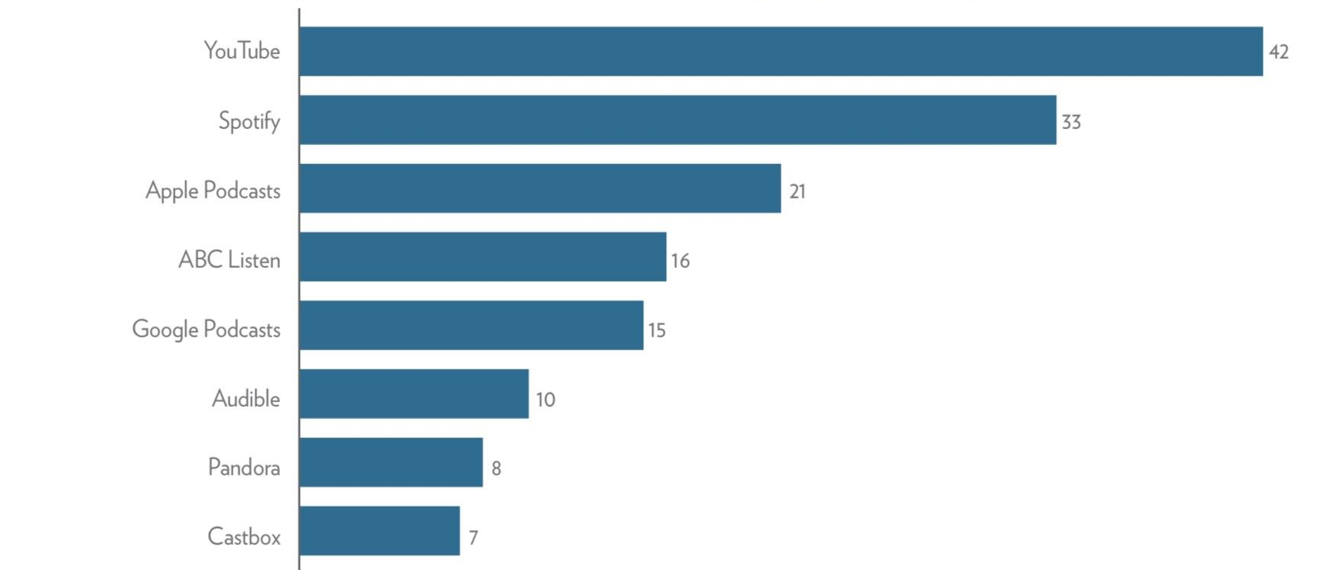
MOST POPULAR PODCAST PLATFORMS IN AUSTRALIA (%)
Source: Sang, Y., Lee, J.Y., & Park, S. (2020). Podcast Trends & Issues in Australia & Beyond: Global Perspectives. News & Media Research Centre, University of Canberra.

Slide 12
69% of podcasts are consumed on a mobile device.
Source: The Infinite Dial Australia 2022 - Edison Research

Slide 13
WHY DO ORGANISATIONS CREATE PODCASTS?
Builds trust, credibility & authority
Engages your audience & stakeholders
Creates a human connection
Reach more people (built in podcast audience)
Boost visibility of the brand

